Slide 1
Employee Data Analysis using Excel
STUDENT NAME: VARJANIYA A S
REGISTER NO: 122204075
DEPARTMENT: B.COM(CORPORATE SECRETARYSHIP)
COLLEGE: SHRI KRISHNASWAMY COLLEGE FOR WOMEN

Slide 2
PROJECT TITLE
Employee Gender Analysis using Excel

Slide 3


AGENDA
Problem Statement
Project Overview
End Users
Our Solution and Proposition
Dataset Description
Modelling Approach
Results and Discussion
Conclusion
3/21/2024 Annual Review

Slide 4

PROBLEM STATEMENT
1.Calculate the gender ratio of our employees
2. Identify the most common job titles held by male and female employees
3. Determine the average salary and bonus for male and female employees
4. Analyze the gender distribution across different departments and levels
5. Identify any potential gender-based disparities in performance ratings, promotions, and training opportunities

Slide 5

PROJECT OVERVIEW
Analyze employee data to calculate gender ratios, identify common job titles, and
determine average salary and bonus
Examine gender distribution across departments and levels
Identify potential gender-based disparities in performance ratings, promotions, and training opportunities
.

Slide 6

WHO ARE THE END USERS?
*HR Managers*: To identify training needs, evaluate employee performance, and make informed decisions about promotions and development opportunities.
*Line Managers*: To monitor team performance, provide feedback and coaching, and make data-driven decisions about resource allocation and staffing.
*Department Heads*: To track departmental performance, identify areas for improvement, and make strategic decisions about resource allocation and budgeting.

Slide 7

OUR SOLUTION AND ITS VALUE PROPOSITION
Unlock the full potential of your workforce with our Employee Gender Analysis solution using Excel. Make data-driven decisions, improve performance management, and drive business growth with actionable insights and automated reporting."

Slide 8
Dataset Description
dataset contains employee Gender data for a fictional company
dataset can be used to analyse employee Gender, identify trends and patterns, and inform decisions about talent development and management

Slide 9
MODELLING
In this I have used pivot table to know about how many employees are there in this organization and in which category, gender, age etc.
I have used if condition to convert the current ratings column which is in the numerical value Into words
I have used conditional formatting to identify the blank areas ( exit date) and that I have highlighted and I have used filter to clear the blank space and make the analysis more easier.
9

Slide 10
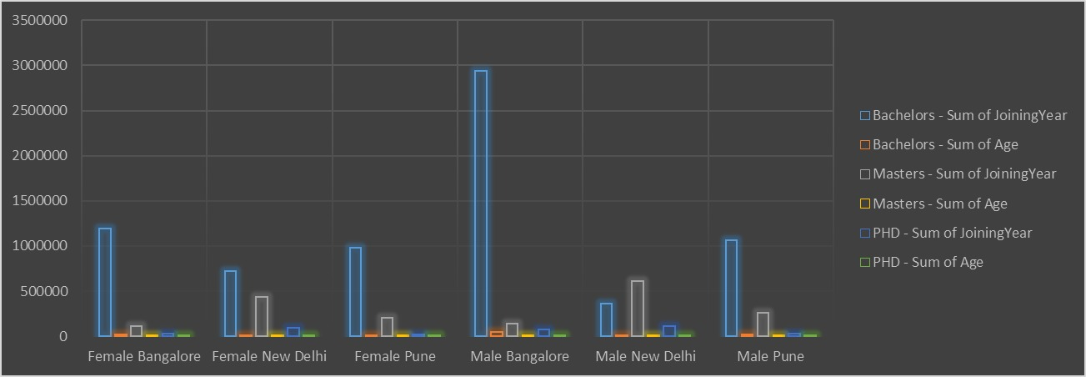
RESULTS
10

Slide 11
conclusion
Data analyzing through the excel by collecting the data's and makes it into the excel this helps to know about the particular matter or analysis in an organization
In this we made an analysis about the employees Gender. With this an organization Can make an wise decision in employees recruitment and they can get to know about the wants and needs of an employee and organization
In this excel we can know about the gender and age and classification of an employees

